Slide 1

Quantum Computing for Everyone
Adrià Blanco - Guillermo Abad - Javier Sabariego - Vyron Vasileiadis

Slide 2
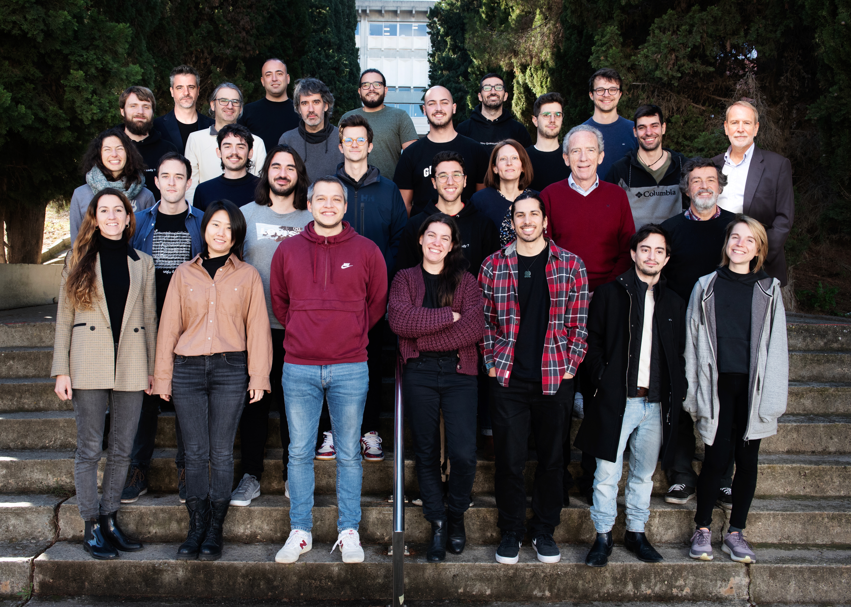
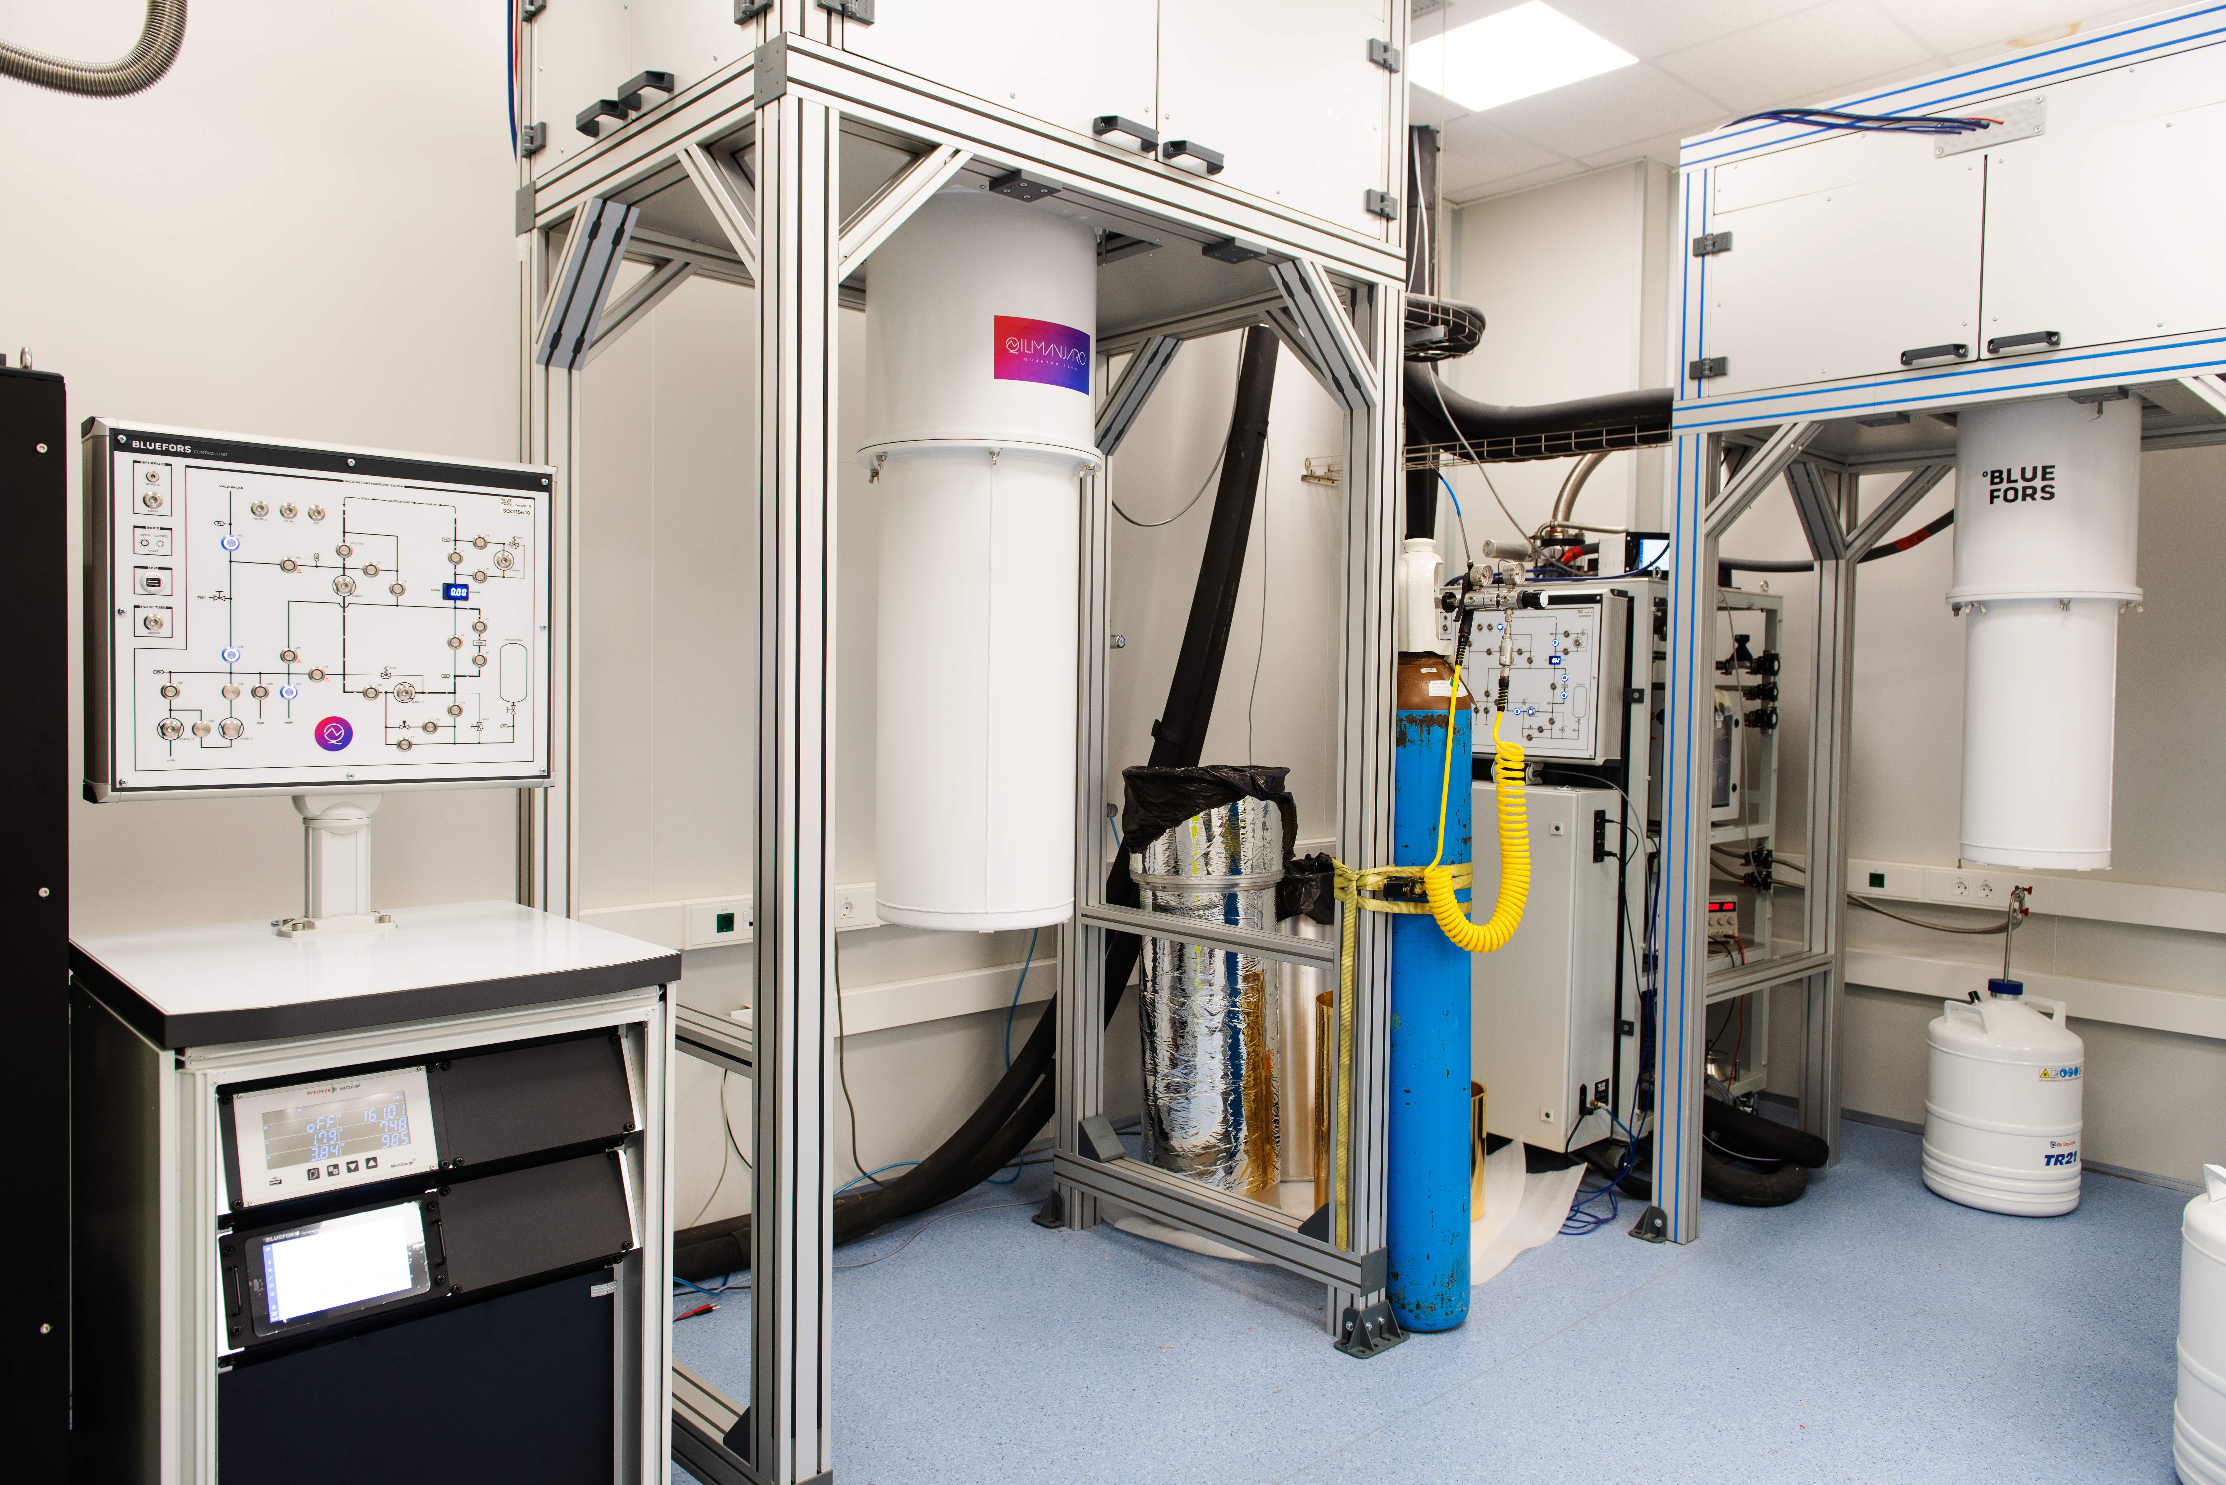
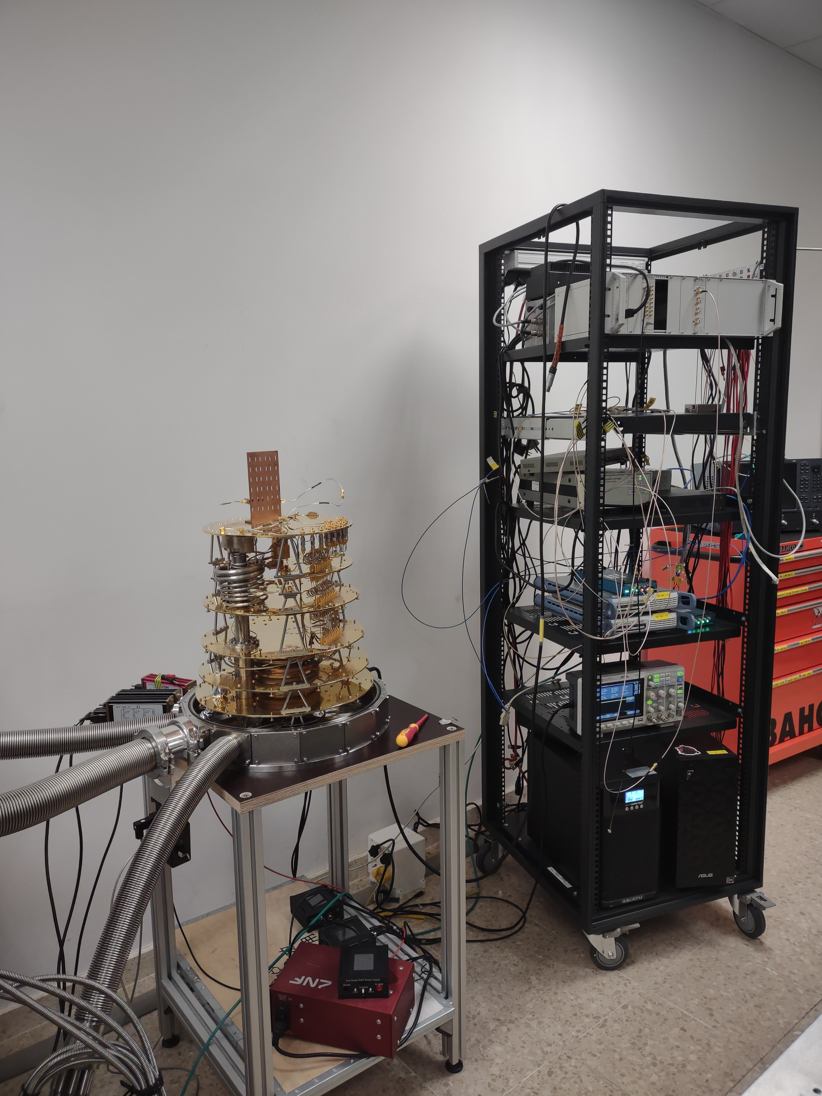
About us
We are quantum engineers at Qilimanjaro.

Slide 3
Workshop Outline
Introduction to Quantum Computing
Programming Quantum Computers in Python
Quantum Teleportation and Quantum Networks

Slide 4
Slido Quiz
The three best scores win a visit to our lab!

Slide 5
Introduction to Quantum Computing

Slide 6




Why Quantum Computing?
There are lot’s of problems that cannot be solved by classical computers
CPU’s have their physical limits
Current classical computing architectures already have unwanted quantum side effects because of their scale
Why try to simulate a complex quantum world in a classical computer?

Slide 7
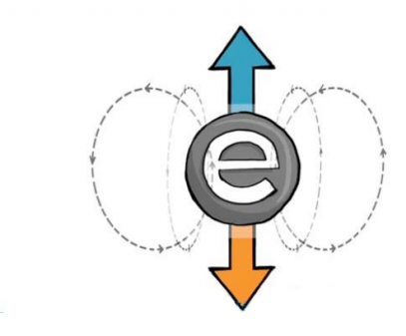
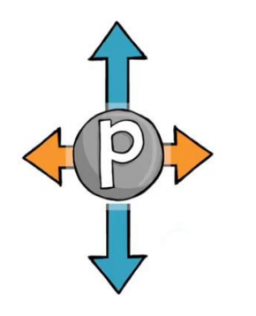
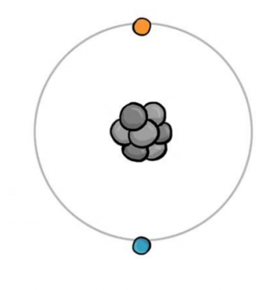

What is a Quantum Computer?
A quantum computer is a machine that stores data and performs calculations based on the laws of quantum mechanics, which is the behavior of particles at the sub-atomic level.
Superconducting circuit’s current
Photon’s polarization
Electron’s magnetic field
Atom’s internal state

Slide 8

Data representation: Qubit
A qubit is a two-dimensional complex-valued vector living in Hilbert space.

Slide 9
Data representation: Qubit
bit = 0
or
bit = 1

Slide 10


Data representation: Qubit
qubit = $\left|0\right\rangle$
or
qubit = $\left|1\right\rangle$
But…

Slide 11

Data representation: Qubit
qubit = $a\left|0\right\rangle +b\left|1\right\rangle$
The qubit can “be” zero and one at the same time!

Slide 12
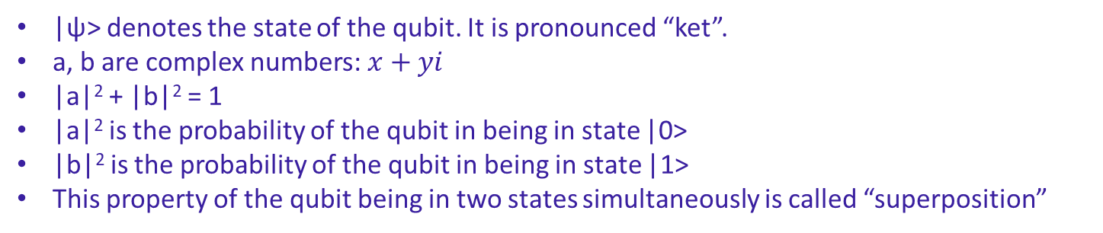

Data representation: Qubit
$$\left|ψ\right\rangle =a\left|0\right\rangle +b\left|1\right\rangle$$
|ψ> denotes the state of the qubit. It is pronounced “ket”.
a, b are complex numbers: $x+yi$
|a|² + |b|² = 1
|a|² is the probability of the qubit in being in state |0>
|b|² is the probability of the qubit in being in state |1>
This property of the qubit being in two states simultaneously is called “superposition”

Slide 13
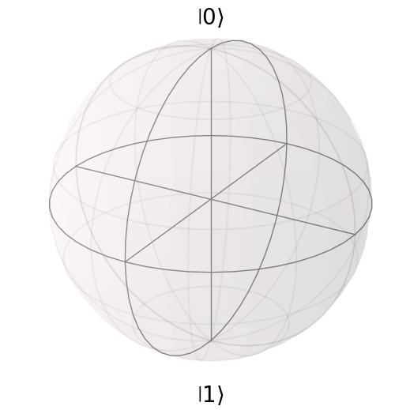
Qubit Visualization: Bloch Sphere

Slide 14
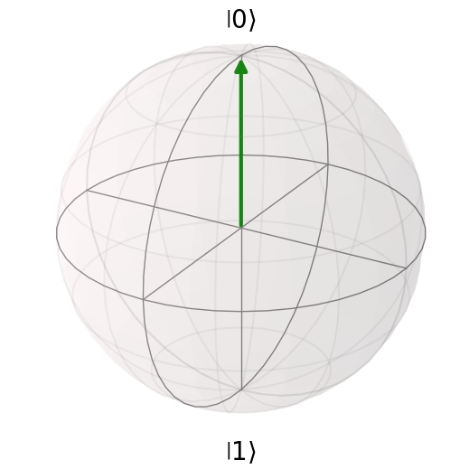
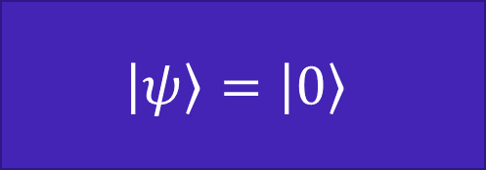
Qubit Visualization: Bloch Sphere
$$\left|ψ\right\rangle =\left|0\right\rangle$$

Slide 15
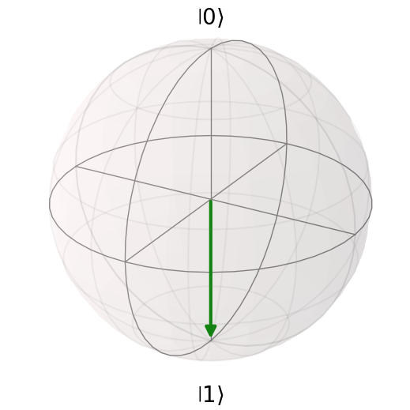
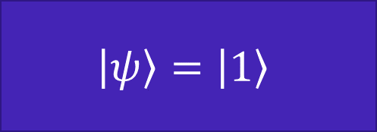
Qubit Visualization: Bloch Sphere
$$\left|ψ\right\rangle =\left|1\right\rangle$$

Slide 16
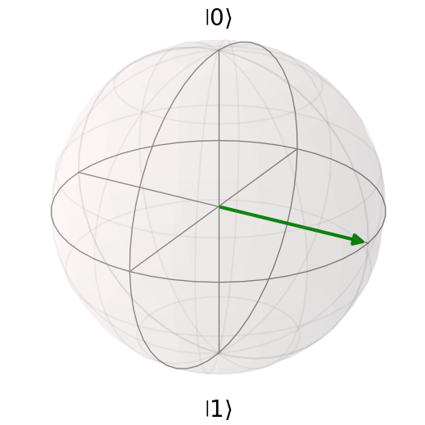
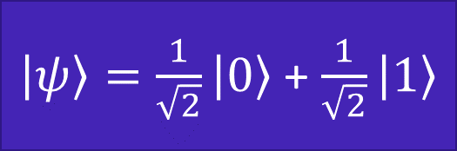
Qubit Visualization: Bloch Sphere
$\left|ψ\right\rangle =\frac{1}{\sqrt{2}}\left|0\right\rangle$ + $\frac{1}{\sqrt{2}}\left|1\right\rangle$

Slide 17
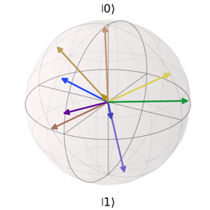
Qubit Visualization: Bloch Sphere

Slide 18
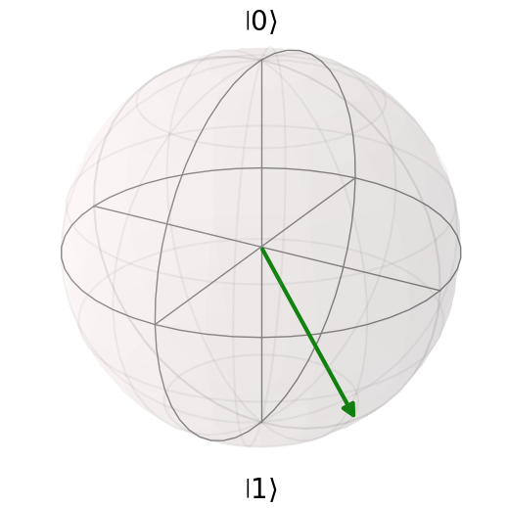
Slido Question!

Slide 19
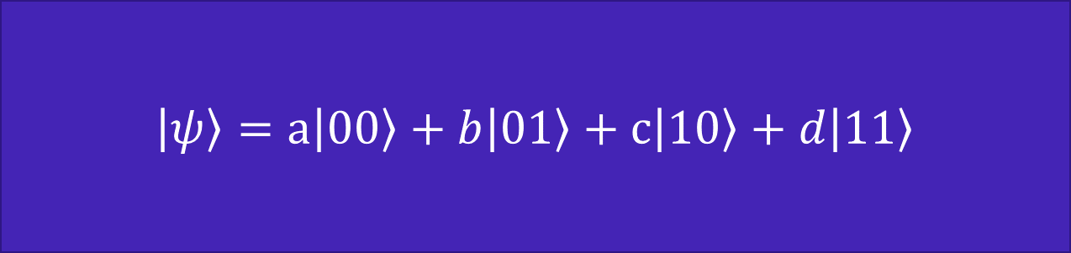
Data representation: 2 Qubits
$\left|ψ\right\rangle =a\left|00\right\rangle +b\left|01\right\rangle +c\left|10\right\rangle +d\left|11\right\rangle$
|a|² + |b|² + |c|² + |d|² = 1
|a|² is the probability of the qubits in being in state |01>
|b|² is the probability of the qubits in being in state |01>
|c|² is the probability of the qubits in being in state |10>
|d|² is the probability of the qubits in being in state |11>

Slide 20
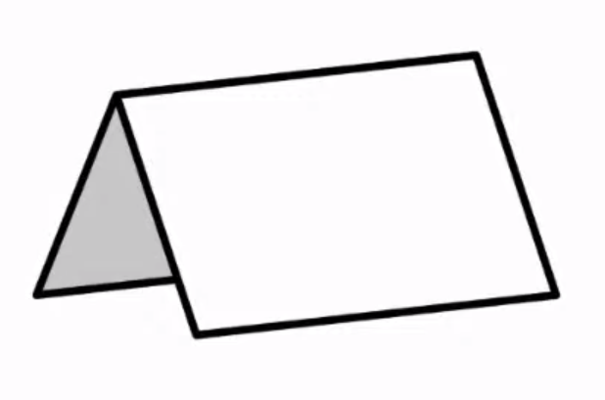
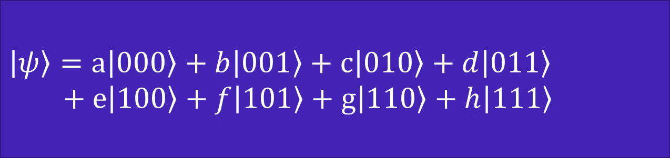
Data representation: 3 Qubits
$$\left|ψ\right\rangle =a\left|000\right\rangle +b\left|001\right\rangle +c\left|010\right\rangle +d\left|011\right\rangle$$
$$+ e\left|100\right\rangle +f\left|101\right\rangle +g\left|110\right\rangle +h\left|111\right\rangle$$
When we add 1 more qubit to the system, its data capacity doubles
This growth is exponentially faster than a classical computer
Fun experiment
0.1 mm
folded 42 times = ?

Slide 21
Quantum states are hidden!
We cannot inspect the current state of our system!
(no cloning theorem)
We can either:
Measure the system and collapse it to classical information
Apply quantum gates that change the state

Slide 22
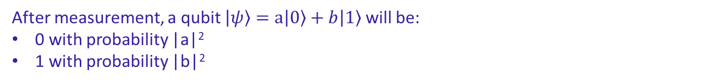
Measurement
Measuring a quantum system collapses it to a classical one
After measurement, a qubit $\left|ψ\right\rangle =a\left|0\right\rangle +b\left|1\right\rangle$will be:
0 with probability |a|²
1 with probability |b|²

Slide 23
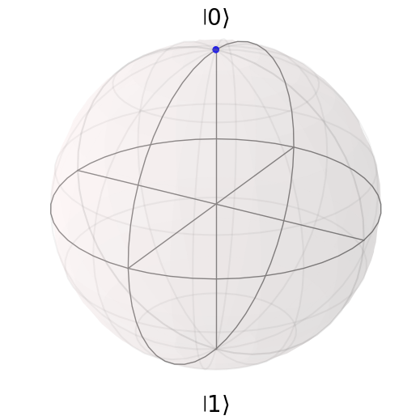

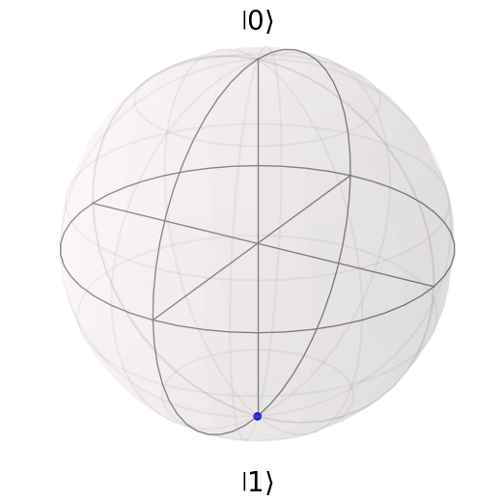

Measurement
with probability |a|²
Measure
$$a\left|0\right\rangle +b\left|1\right\rangle$$
with probability |b|²

Slide 24
Quantum gates
Gates act on qubits and change their state
Quantum gates are unitary operators, and are described as unitary matrices
They are reversible

Slide 25
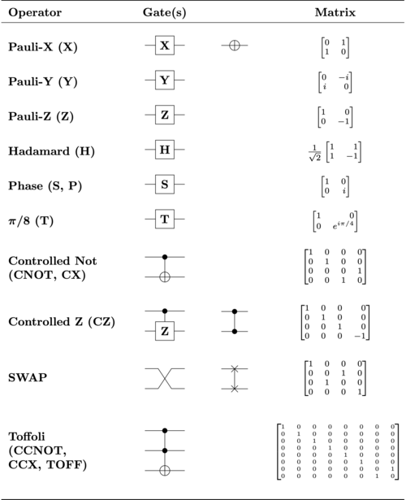
Quantum gates

Slide 26
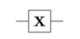




Example: X gate
X gate reverses the qubit’s state (like NOT gate in classical computing)
$$\left|0\right\rangle$$
$$\left|1\right\rangle$$
$$\left|1\right\rangle$$
$$\left|0\right\rangle$$

Slide 27
Example: X gate
X
X

Slide 28
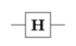
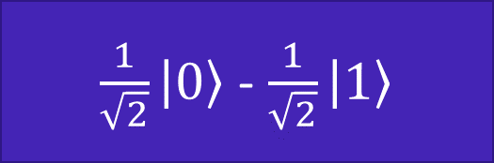
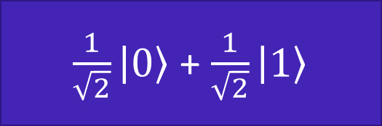
Example: Hadamard gate
Hadamard gate sets qubit’s state to an equal superposition
$$\left|0\right\rangle$$
$\frac{1}{\sqrt{2}}\left|0\right\rangle$ + $\frac{1}{\sqrt{2}}\left|1\right\rangle$
$$\left|1\right\rangle$$
$\frac{1}{\sqrt{2}}\left|0\right\rangle$ - $\frac{1}{\sqrt{2}}\left|1\right\rangle$

Slide 29
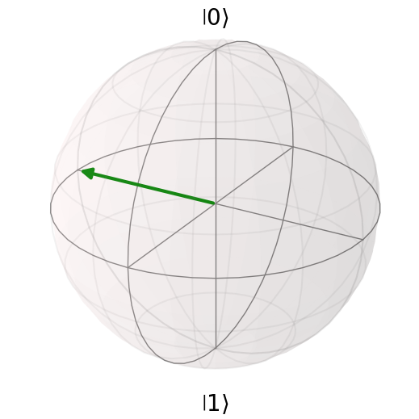
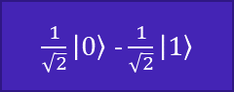
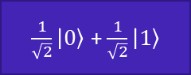
Example: Hadamard gate
H
$\frac{1}{\sqrt{2}}\left|0\right\rangle$ + $\frac{1}{\sqrt{2}}\left|1\right\rangle$
H
$\frac{1}{\sqrt{2}}\left|0\right\rangle$ - $\frac{1}{\sqrt{2}}\left|1\right\rangle$

Slide 30
Programming Quantum Computers in Python

Slide 31
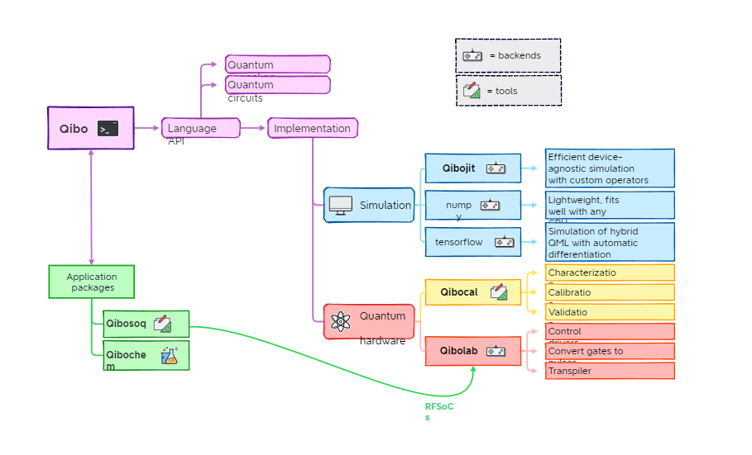
Qibo
Qibo is an open-source middleware for quantum computing written in Python

Slide 32
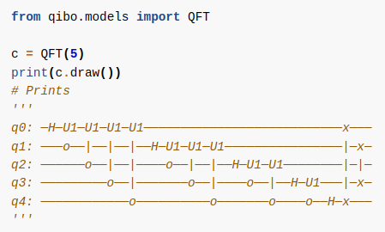
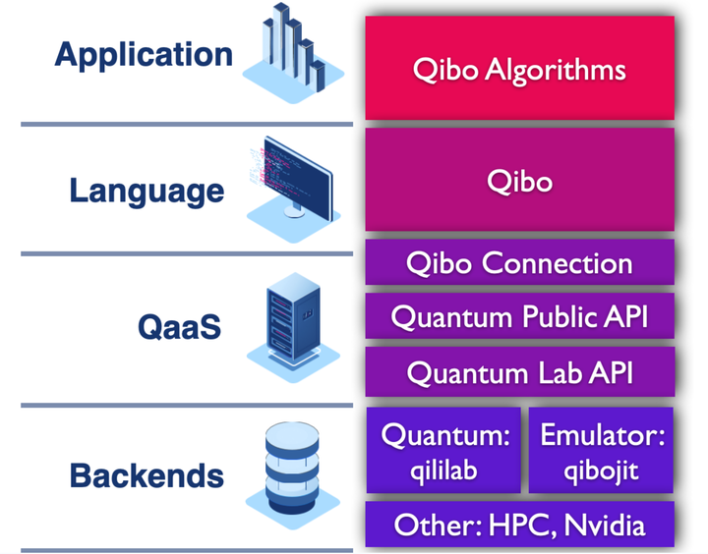
Software Stack
from qiboconnection import API
>>> api = API.login(username="qat", api_key="meow")
[qibo-connection] 0.12.0|INFO|2023-09-21 18:16:26]: Storing personal qibo configuration...

Slide 33
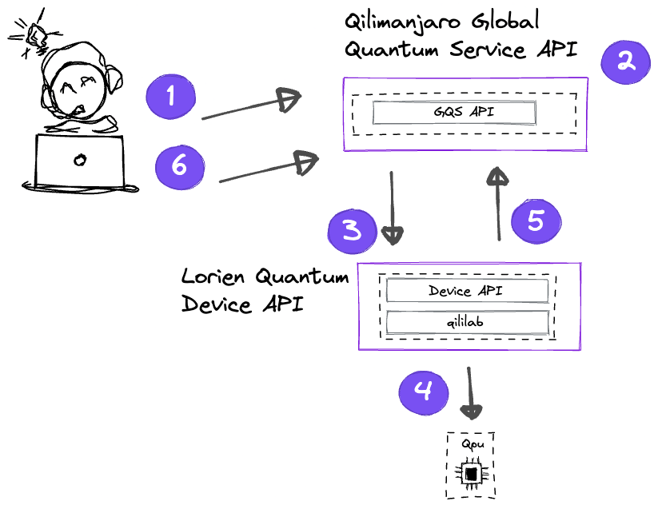
QaaS Workflow
Typical workflow
User submits a job using Qiboconnection and gets a job_id.
Our Public API receives and processes the request.
Request is relayed to the corresponding device.
QPU or simulator performs the due operations.
Results are sent to our Public API.
User can retrieve the results using their job_id.

Slide 34
Using Qiboconnection for quantum jobs
Open provided notebook in your IDE
Install qibo and qiboconnection in your python environment. In a terminal:
pip install qibo
pip install qiboconnection
Log into Qilimanjaro’s QaaS with the following credentials:
username = ‘pyday23-username’, api_key=’pyday23-apikey’
NOTE: Unluckily, you’ll have access to the development server, not the production one with the quantum chip. That’s why os.environ["QIBOCONNECTION_ENVIRONMENT"] = "development"

Slide 35
https://qibo.science/

Slide 36
Demo

